Slide 1
Četvrta nedelja Utorak Dvanaesti septembar/rujan
Tamara Pavlović BCS 2023

Slide 2
Akuzativ množina review
Ja sad mislim na ___________ (crvena mačka). I’m thinking about black cats right now.
Mi gledamo __________ (lepa/lijepa ptica). We are looking at the beautiful birds.
Ko/Tko piše ___________ (dugo pismo)? Who is writing long letters?
Baš volim _________ (mali grad). I really love small cities.
Tvoj otac traži _________ (svoj pas). Your father is searching for his dogs.

Slide 3
Present Tense of the verb to be
I am
You are
He, She, It is
We are
You are
They are
Ja sam
Ti si
On, Ona, Ono je
Mi smo
Vi ste
Oni, One, Ona su

Slide 4
Negative forms
I’m not
You’re not
He, She, It is not
We are not
You’re not
They are not
Ja nisam
Ti nisi
On, Ona, Ono nije
Mi nismo
Vi niste
Oni, One, Ona nisu

Slide 5
Interrogative forms
Am I
Are you
Is he/she/it
Are we
Are you
Are they
Jesam li (ja)
Jesi li (ti)
Je li (on/ona/ono)
Jesmo li (mi)
Jeste li (vi)
Jesu li (oni/one/ona)

Slide 6
Interrogative forms
Using DA LI
Here word order is like in English:
Am I a teacher?
Da li sam ja učitelj?
Da li sam (ja)
Da li si (ti)
Da li je (on/ona/ono)
Da li smo (mi)
Da li ste (vi)
Da li su (oni,one,ona)

Slide 7
Sadašnje vreme

Slide 8
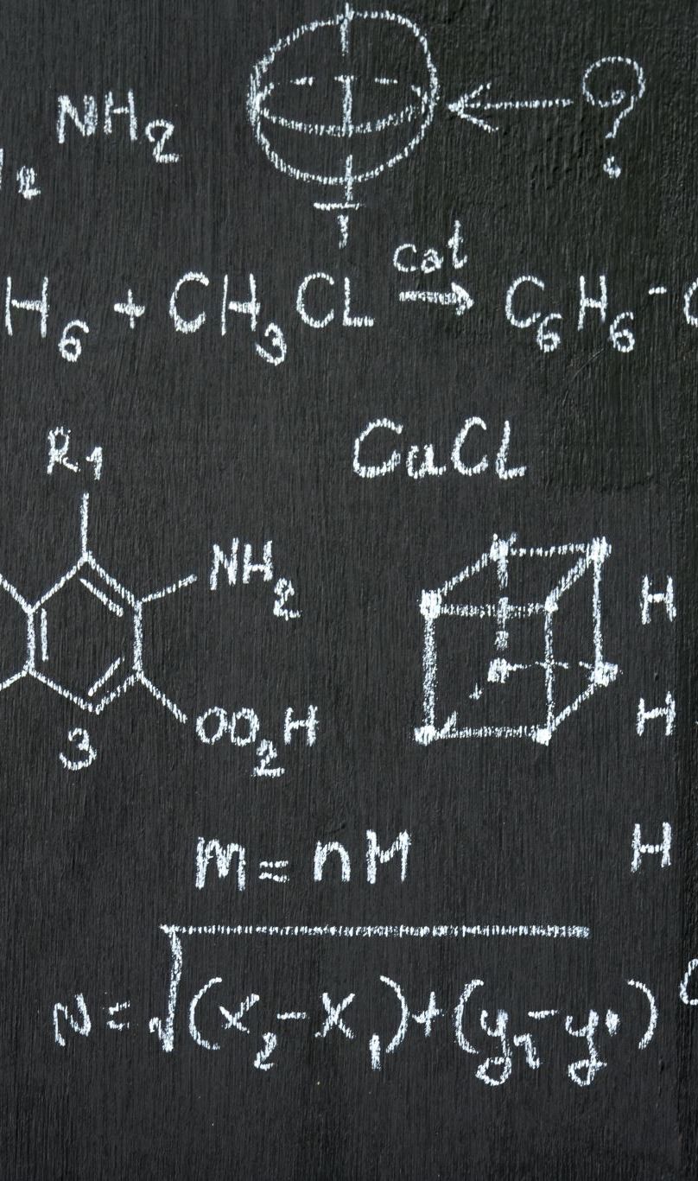
Components of the present tense
A: Personal endings:
1.p.sg. –m 1.p.pl. -mo
2.p.sg –š 2.p. pl. -te
3. p.sg. zero 3. p.pl. zero ending

Slide 9
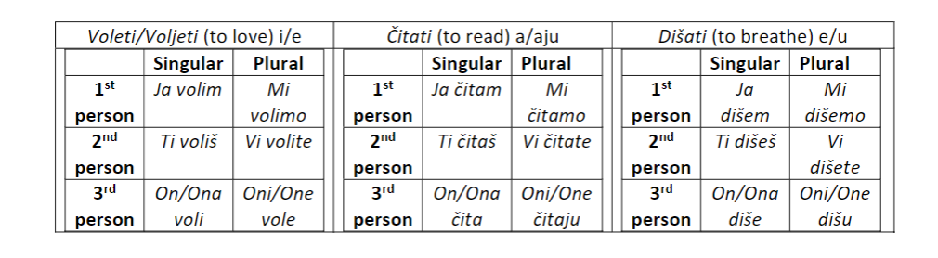



B:Present Tense Markers
Immediately precede the personal endings and occur in 3 combinations determining a type of present tense
Look at the 1st p.sg and 3rd p. plural to find the markers

Slide 10
Conjugation of učiti i-e type
Ja učim *marked red present tense type
Ti učiš ** marked blue personal endings
On,Ona,Ono uči
Mi učimo
Vi učite
Oni,One,Ona uče

Slide 11
Conjugation of the pevati/pjevati a/ju type
Ja pevam/pjevam
Ti pevaš/ pjevaš
On,Ona,Ono peva/pjeva
Mi pevamo/ pjevamo
Vi pevate/pjevate
Oni,One,Ona pevaju/pjevaju

Slide 12
Conjugation of the pisati e/u type
Ja pišem
Ti pišeš
On,Ona,Ono piše
Mi pišemo
Vi pišete
Oni pišu

Slide 13
Negative forms
Are formed by adding NE before the main verb (spelled separately from the main verb!!!)
Ja ne radim Mi ne radimo
Ti ne radiš Vi ne radite
On,Ona,Ono ne radi Oni, One, Ona ne rade

Slide 14
Important exceptions
Verb not to have:
Ja nemam Mi nemamo
Ti nemaš Vi nemate
On, Ona, Ono nema Oni, One, Ona nemaju
Note: to have- imati
Not to have- nemati (spelled as one word!!!)

Slide 15
Negative form of the verb to be
Ja nisam Mi nismo
Ti nisi Vi niste
On, Ona, Ono nije Oni, One, Ona nisu
Note: spelled as one word
Translates as :I am not, you are not, etc.

Slide 16
Vežba
Ja ……………. (čitati (inf.), čita(present stem), a/ju)
Mi …………… (spremati, sprema, a/ju)
Studenti ………….. (ići, id, e/u)
Vi …………… (pisati, piš, e/u)
Ona …………. (ne govoriti, govor, i/e)
TX- Lesson 3, Vežba 5
Make your own sentences using verbs for vocabulary test

Slide 17
Za sutra
Homework: Conjugation
Resubmission: Akuzativ Homework (Week 3)
Prep: 218-219

